Slide 1

Psyche Simulator
By Andrew Turnbull, Zedekiah Davis, Nick Campbell, & Caleb Nuttall

Slide 2
The Problem
Our project tackles the challenge of simulating a realistic craft flying toward the asteroid Psyche.
Domain Space: Aerospace and space mission simulation, with a focus on accurate modeling in low-gravity environments.
Elicitation Techniques:
We used stakeholder interviews and closely studied the work left by the team before us.
Key Issues Identified:
Prior to our work, there was a 2d simulator for landing on Psyche—users could make basic inputs and view static images.
This gap limited both training and public understanding of the complex dynamics involved in such a landing.

Slide 3
The Expert
Psyche Mission Simulator gives the public a front-row seat to the Psyche mission from launch through orbit... and beyond. The chance for the public to experience, and even control, the mission and then imagine what follow-on mission could entail will excite and inspire so many people.
- Professor Cassie Bowman

Slide 4
The Past Solutions
Legacy Solutions:
The mission was vividly described alongside images of how we believe the orbit will occur. There was also a very simple 2D simulator.
Customer Feedback:
An interactive simulator would offer a more visceral experience that will stress the mathematics and skill required for the mission.

Slide 5
The New Solution
Follow mission on the way to psyche
Three dimensional model instead of 2 dimensional
Create simulation framework
Distinguish between current mission status and potential future missions

Slide 6
Feature Expectations
3D Model / Simulator Framework
Able to be used to effectively model new missions using existing framework
Import custom objects (Blender)
Can connect to a physics library for accurate simulations (Three.js Rapier)
Models can receive user inputs allowing for an interactive experience

Slide 7
Bring The Expert Back
We can't wait to let people take a deep dive into the Psyche mission with Psyche Mission Simulator!
- Professor Cassie Bowman

Slide 8
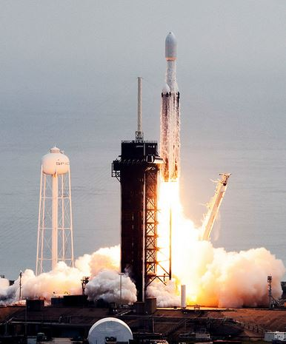
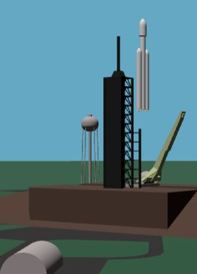
The Pitch
Launch

Slide 9
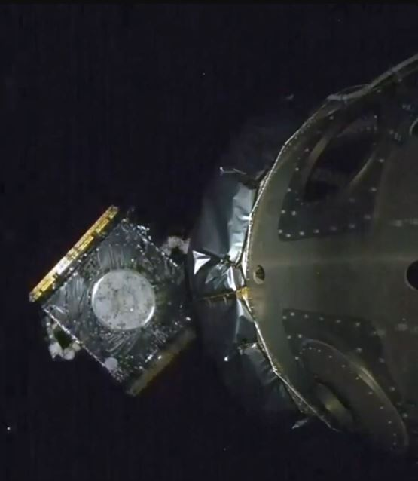
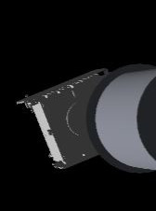
Separation

Slide 10
The Bonus
3d rendering
Mission selection
Multiple viewpoints for each mission

Slide 11
The Sense of Urgency
Lessons Learned:
The project has reinforced the importance of physics modeling and iterative feedback in developing educational tools.
It has expanded our expertise in modern web technologies and simulation design.
Personal Impact & Future Opportunities:
This project is a key highlight on our resumes and professional profiles, showcasing our capability to create innovative, accessible educational software.

Slide 12
Our Story
STAR Story:
Situation: We were tasked with creating a realistic simulation of a craft orbiting the asteroid Psyche, intended as a free educational tool.
Task: Develop an interactive, physics-accurate simulation using cutting-edge web technologies.
Action: Leveraged React, Three.js, and extensive user input to design, build, and refine the simulation.
Result: Delivered a framework to build a simulation to serve as a valuable educational resource.
Call to Action

